Slide 1
COS 301
&
DVT
Kinder Finder
Uteshlen Nadesan 28163304 Team Leader
Michael Johnston 12053300 Lead Programmer
Po-Han Chiu (Arthur) 11063612 Psychological Counsellor

Slide 2
DVT
Software development company
Specialising in mobile application development for firms and companies
  E.g.
    Price Check app
    Standard bank tablet app
    Vodacom/MTN tracking app
Located in Hyde Park, JHB

Slide 3
Kinder Finder
A Vision
Many restaurants aim to give parents a worry free dining experience
However, a parent still has the worry
  They have a consistent need to ensure their children are still in the safe and designated areas
This solution will attempt to assist the parents in being able to make sure their children are still in these areas without the need to get up from their tables

Slide 4
What is
Kinder Finder
Using RFID receivers and transmitters to track the whereabouts of children in an area
  E.g. In a restaurant
Parents (of the children) are able to track their child’s location via
  Smart phone
  Table map (optional)

Slide 5
Kinder Finder
Web Administration
  Basic Reporting
    Statistics
    Zone use
    Errors
Mobile Application
Web API
Embedded Hardware and prototyping (POC).
  Nice-to-have (unless we finish implementation early)

Slide 6
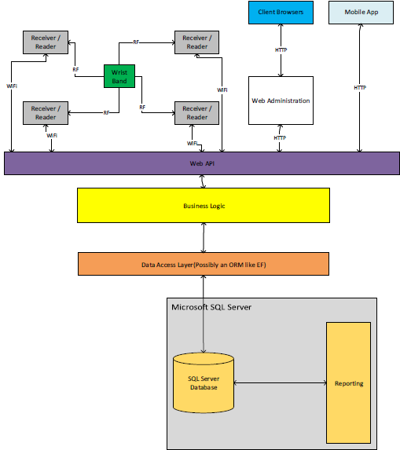

Slide 7
Technologies
Programming Language (Primary)
  C#
Database
  SQL Server Express 2012
Data Access Layer
  Entity Framework (ORM)

Slide 8
Technologies
Web Development
  ASP.Net MVC 5
  WebAPI 2.2
IDEs
  Microsoft Visual Studio 2013 Professional
  Xamarin Studio

Slide 9
Demo User Details
Administration Portal
  Username: admin
  Password: Password1!
Android App
  Email Address: test@example.com
  Password: computer

